Slide 1
Is “Hindu mathematics” a European idea?
Gleanings on the politics of the history of
arithmetics in India from the 19th century
to the 21st century
By Deepthi sri

Slide 2
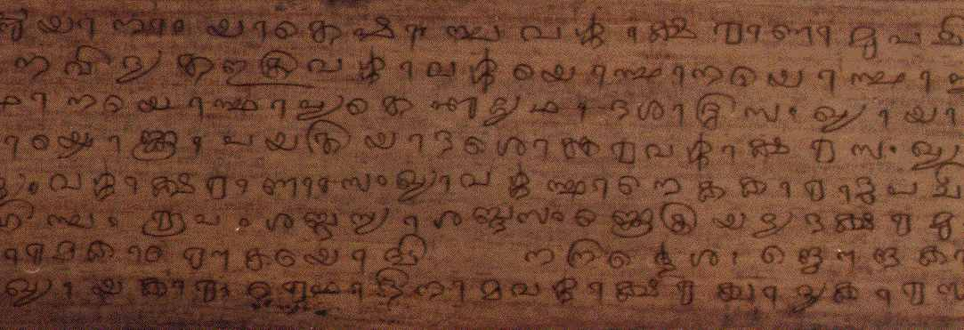
Chronology : vedic culture
All dates should be taken cautiously
-2500 (-5000) -1000 Vedas
-1500 – 1000 Pânîni
-1200 Vedângajyotisa
Ca. –500 sulbasûtras

Slide 3
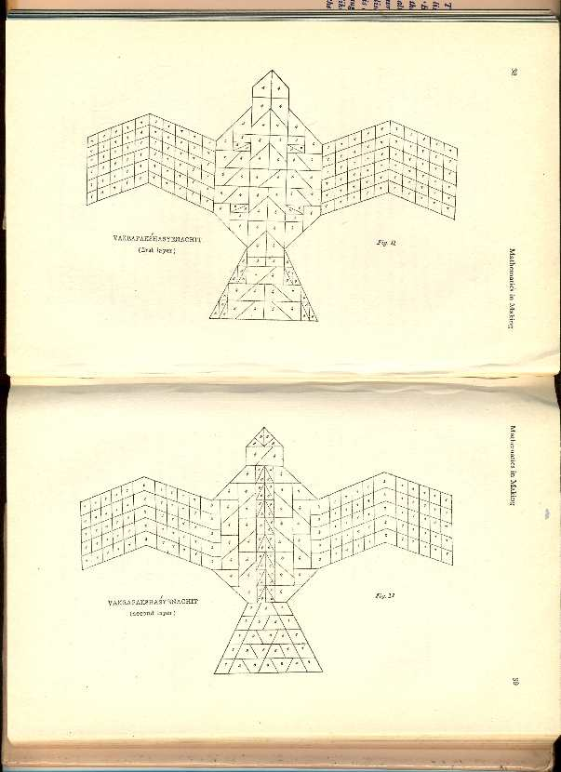
Illustrations of different syenaciti (eagle altars)

Slide 4
Classical mathematics in Sanskrit
499
the Âryabhatîya of Âryabhata
Its second chapter is devoted to mathematics (ganita)
This chapter includes a definition of the decimal place value notation

Slide 5
Rodet’s Opinion on Indian Mathematics
«Mais tandis que les Grecs étaient en géométrie d'une force qui nous étonne tous les jours, et en calcul les ignares que l'on sait (…) les Indiens, au contraire, ont été� peu habiles géomètres, même après les leçons qu'ils ont pu recevoir des Grecs, tandis qu'ils ont eu pour le calcul une disposition naturelle toute particulière, ainsi qu'il ressort des exemples bien connus de calculs compliqués effectués par eux �à des époques qui remontent jusqu'� à une antiquité légendaire»
L'algèbre d'Al-Khârizmi et les méthodes indienne et grecque
p. 12-13, 1878

Slide 6
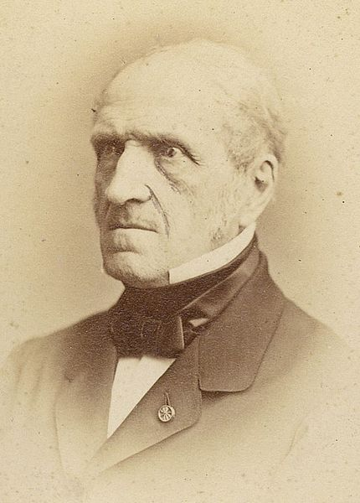
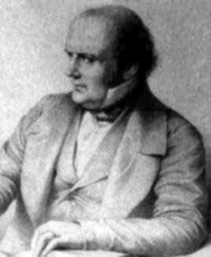
The Chasles - Libri controversy
Michel Chasles (1793-1880)
Gugliemo Libri (1803-1869)

Slide 7
George Rusby Kaye’s strange denial
« We can go further and state with perfect truth
that, in the whole range of Hindu mathematics,
there is not the slightest indication of the use
of any idea of place-value before the tenth
Century A. D. »
Notes on Indian Mathematics.- Arithmetical Notation,
July 1907.

Slide 8
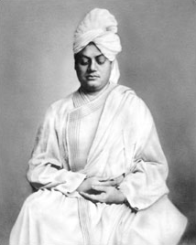
Vivekananda
1863-1902
« Vivekananda laid the foundations of a neo-Hindu apologia that not just found the most advanced speculative sciences as always-already there in Hinduism, but also presented India as the 'guru' who will teach the West how to use science in a spiritually meaningful manner. »
Raina, Dhruv 1997 Evolving perspectives on science and history : a chronicle of modern India's scientific enchantment and disenchantment (1850-1980). Social Epistemology 11: 3-24.

Slide 9
Working with Indian Pandits
« To aid in prosecuting my inquiry, I begged
Kamalākānta to point out any allusions to the
forms of the ancient numerals he might have
met with in grammars or other works, but he
could produce but very few instances to the point. »
James Pinsep.

Slide 10
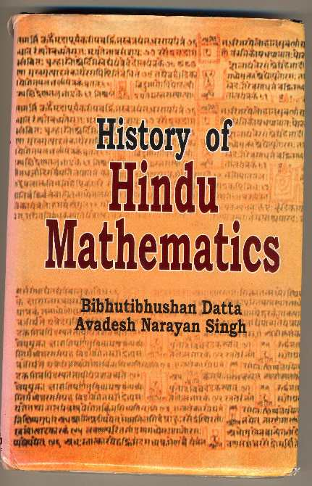

Slide 11
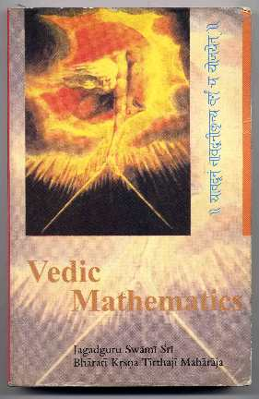
Year 2000 edition

Slide 12
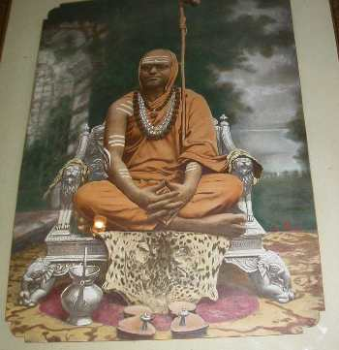
The young KṚṢṆA BhĀratĪ ThĪrhajĪ

Slide 13
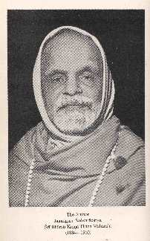
KṚṢṆA BhĀratĪ ThĪrhajĪ In his old age

Slide 14
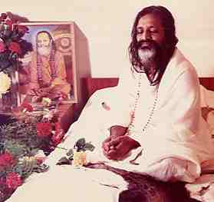
Posterity of Vedic Mathematics: The Maharishi

Slide 15
Multiplying 9 by 7
Note 9 and 7 within a column
9
7
Note their difference with 10 in a column as well
9 -1
7 -3
Then you have four choices
Using the left hand column
(9+7)-10= 6
Crosswise
(9-3) ou (7-1) =6
Using the right hand column
10-(3+1)=6

Slide 16
Multiplying 9 by 7
The previous result is noted on the left
9 -1
7 -3
6
On the right 1 and 3 are multiplied,
and the result noted below
9 -1
7 -3
6 3
Is the result

Slide 17
Multiplying 998 by 997
The system will be the same, only 1000
will be the base, instead of ten
The numbers are noted within a column
998
997
Noting their difference with 1000
998-002
997-003
Using the columns
1000-(2+3)
997+998-1000
Or Crosswise
998-3
997-2
=995=

Slide 18
Multiplying 998 by 997
The previous result is noted on the left, and the product of the right hand column on the right
998-002
997-003
995 006
Is the result

Slide 19
In fact, old historical traditions describe this cross-subtraction process as having been responsible for the acceptance of the × mark as the sign of multiplication VM p. 13

Slide 20
Vedic Mathematic’s historical representations: a post-colonial trend
A pandit replying to orientalist claims (ambivalent feelings toward the academia)

Slide 21
the mathematically most advanced present day Western scientific world had spent huge lots of time, energy and money on and which even now it solves with the utmost difficulty and after vast labour involving large numbers of difficult, tedious and cumbersome “steps” of working (…) can easily and readily [be] solved with the help of these ultra-easy Vedic Sūtras (…) in a few simple steps and by methods which can be conscientiously described as mere “mental arithmetic”.
VM p. xli

Slide 22
to unravel the too-long hidden mysteries of philosophy and science contained in ancient India’s Vedic lore, with the consequence that, after eight years of concentrated contemplation in forest-solitude, we were at long last able to recover the long lost keys which alone could unlock the portals thereof
VM p. xxxix

Slide 23
Vedic Mathematic’s Historiographical representations
Meditation and austerities as methods of historical and mathematical investigation
And
A claim to recognize India’s contribution to the world history of mathematics
(religious discipline and rational inquiry are on the same level)

Slide 24
Vedic Mathematic’s sub-text Historiography
Indian mathematics is older than classical greek mathematics
Old Indian mathematics was computational in nature

Slide 25
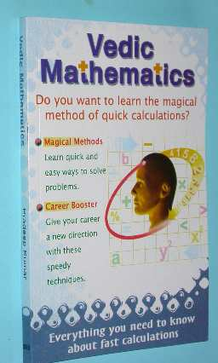
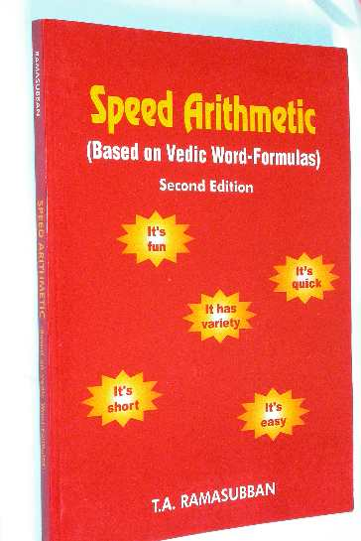
Posterity of Vedic Mathematics

Slide 26
Vedic Science
We now know that Vedic knowledge embraced physics, mathematics, astronomy, logic, cognition and other disciplines. We find that Vedic science is the earliest science that has come down to mankind.
Subhash Kak, Computing Science in Ancient India.

Slide 27
This powerpoint was kindly donated to
www.worldofteaching.com
Home to well over a thousand free powerpoint presentations submitted by teachers. This a free site. Please visit and I hope it will help in your teaching

